Slide 1
React.js
The core of React
Notes:
Add instructor notes here.

Slide 2
Lesson Objectives
At the end of this module you will be able to:
Recall React's Top-Level API
Perform the following functions under React Library-
React.createElement
ReactDOM.render
ReactDOMServer.renderToString
ReactDOMServer.renderToStaticMarkup
React.createClass
React.Children.count
React.Children.map
React.Children.forEach
Transform JSX to native JavaScript using Babel compiler
Notes:
Add instructor notes here.

Slide 3
The core of React React Top-Level API
React is the entry point to the React library.
Following are some of the important functions under React Library:
React.createElement
ReactDOM.render
ReactDOMServer.renderToString
ReactDOMServer.renderToStaticMarkup
React.createClass
React.Children.count
React.Children.map
React.Children.forEach
Notes:
Add instructor notes here.

Slide 4
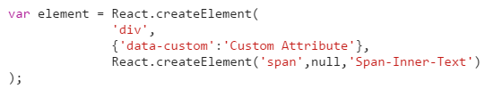
The core of React React.createElement
The createElement method will generate a new ReactElement.
It is created using at least one, and optionally up to three, arguments to the function a string type, optionally an object props(attributes), and optionally children (text / element)
React.createElement( type, [props[, [children ...] );
This function available in the following library -
https://cdnjs.cloudflare.com/ajax/libs/react/0.14.7/react.js
Notes:
Add instructor notes here.

Slide 5

The core of React ReactDOM.render
Render a ReactElement into the DOM in the supplied container and return a reference to the component
If the ReactElement was previously rendered into container, this will perform an update on it and only mutate the DOM as necessary to reflect the latest React component
If the optional callback is provided, it will be executed after the component is rendered or updated
ReactDOM.render( element, container [, callback ] );
Notes:
data-reactid=".1" attribute in the div tag is added and used by React to track the DOM nodes; it might be removed in a future version of React.
Add instructor notes here.

Slide 6

The core of React ReactDOMServer.renderToString
Render a ReactElement to its initial HTML. This should be used only on the server. React will return an HTML string
This method is used to generate HTML on the server and send the markup down on the initial request for faster page loads and to allow search engines to crawl your pages for SEO purposes
If React.render() called on a node that already has this server-rendered markup, React will preserve it and only attach event handlers to have a very performant first-load experience
ReactDOMServer.renderToString(reactElement);
Notes:
Add instructor notes here.

Slide 7

The core of React ReactDOMServer.renderToStaticMarkup
Similar to renderToString, except this doesn't create extra DOM attributes such as data-react-id, that React uses internally
This is useful if you want to use React as a simple static page generator, as stripping away the extra attributes can save lots of bytes
ReactDOMServer.renderToStaticMarkup(reactElement);
This function available in the following library -
https://cdnjs.cloudflare.com/ajax/libs/react/0.14.7/react-dom-server.js
Notes:
Add instructor notes here.

Slide 8
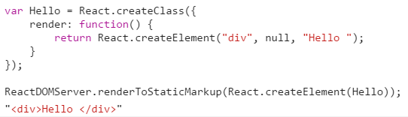
The core of React React.createClass
The createClass method will create a new component class in React
createClass can be created with an object, which must have a render() function
React.createClass(specification);
This function available in the following library -
https://cdnjs.cloudflare.com/ajax/libs/react/0.14.7/react.js
Notes:
Add instructor notes here.

Slide 9
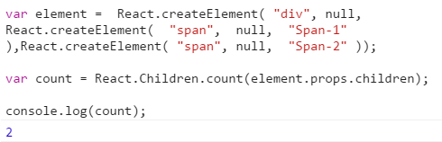
The core of React React.Children.count
The count method will return the number of components that are contained in element
The method accepts a single argument an object
React.Children.count(childrenObject);
This function available in the following library -
https://cdnjs.cloudflare.com/ajax/libs/react/0.14.7/react.js
Notes:
Add instructor notes here.

Slide 10
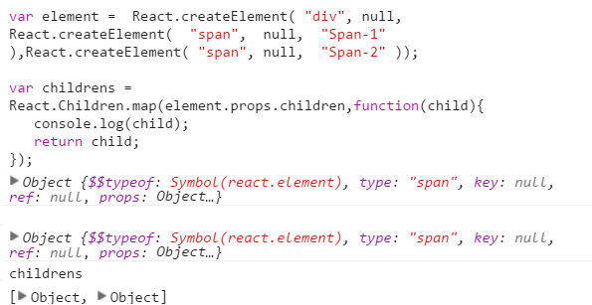
The core of React React.Children.map
It perform a function on each of the immediate children contained and will return an object
React.Children.map(children, myFn [, context])
This function available in the following library -
https://cdnjs.cloudflare.com/ajax/libs/react/0.14.7/react.js
Notes:
Add instructor notes here.

Slide 11
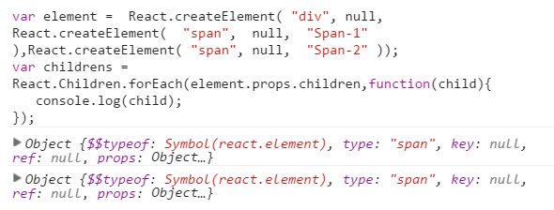
The core of React React.Children.forEach
It perform a function on each of the immediate children contained and will return an object
React.Children.map(children, myFn [, context])
This function available in the following library -
https://cdnjs.cloudflare.com/ajax/libs/react/0.14.7/react.js
Notes:
Add instructor notes here.

Slide 12
The core of React JSX Introduction
When we build our virtual DOM by constantly calling the React.createElement() method, it becomes difficult to visually translate these multiple function calls into a hierarchy of HTML tags
JSX allows us to create a virtual DOM tree without using the React.createElement() method
It is a JavaScript syntax extension that looks similar to XML
It can be transformed into native JavaScript using compiler like Babel
Babel-core can be downloaded from the following CDN to perform the transformation in the browser
https://cdnjs.cloudflare.com/ajax/libs/babel-core/5.8.34/browser.js
JSX code must be placed with in the script tag marked with type="text/babel " to concert into JavaScript
Notes:
Add instructor notes here.
Note : Since JSX is JavaScript, identifiers such as class and for are discouraged as XML attribute names. Instead, React DOM components expect DOM property names like className and htmlFor, respectively.
You can’t just use HTML comments inside of JSX because it thinks they are real DOM Nodes:
render() {
return (
<div>
<!-- This doesn't work! -->
</div>
)
}
You can use regular /* Block Comments */, but they need to be wrapped in curly braces:
{/* A JSX comment */}
Same goes for multiline comments:
{/*
Multi line
comment
*/}

Slide 13
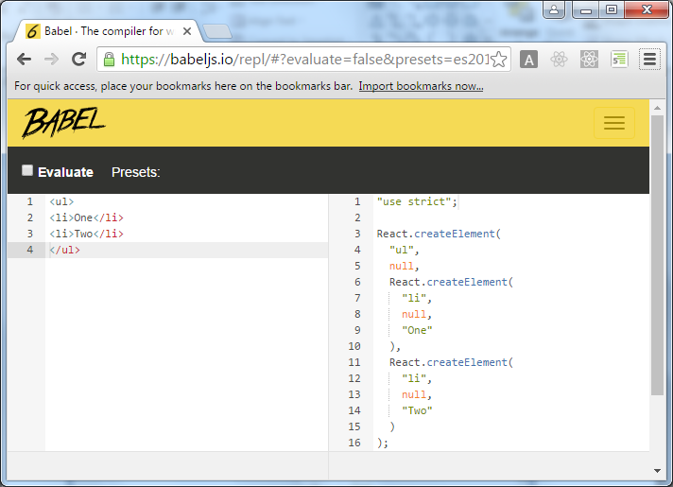
The core of React Babel online compiler
We can try out Babel compiler online from: https://babeljs.io/repl/
Notes:
Babel preprocess the JSX to plain JavaScript at runtime in the browser. Doing this every time slows down the application, but if we transform JSX before the runtime makes the application to run faster. We can transform JSX manually by compiling it through some online compilers like Babel or by installing appropriate node packages in the node environment
Add instructor notes here.

Slide 14
Demo
Compiling-JSX-To-JavaScript-InternalJS
Compiling-JSX-To-JavaScript-ExternalJS
Notes:
Add instructor notes here.

Slide 15
Summary
In this module you learnt that:
React.createClass() is used to create a new component class based on the given specification. It is available in the package react
ReactDOM.render() is used to render a ReactElement into the DOM in the supplied container. It is available in the package react-dom
Transforming JSX to native JavaScript before the runtime makes the application to run faster
JSX can be manually compiled through online compilers like Babel or by installing appropriate node packages in the node environment
Notes:
Add the notes here.
Add instructor notes here.

